Slide 1

Exclamations 感叹句!
教师：刘春燕
工作单位：新余新兴产业工程学校

Slide 2
Objectives
By the end of the lesson, you will be able to:
Change a declarative sentence（陈述句）into an exclamation
Choose “what” or “how” to form exclamations correctly
Express your strong feelings with exclamations

Slide 3
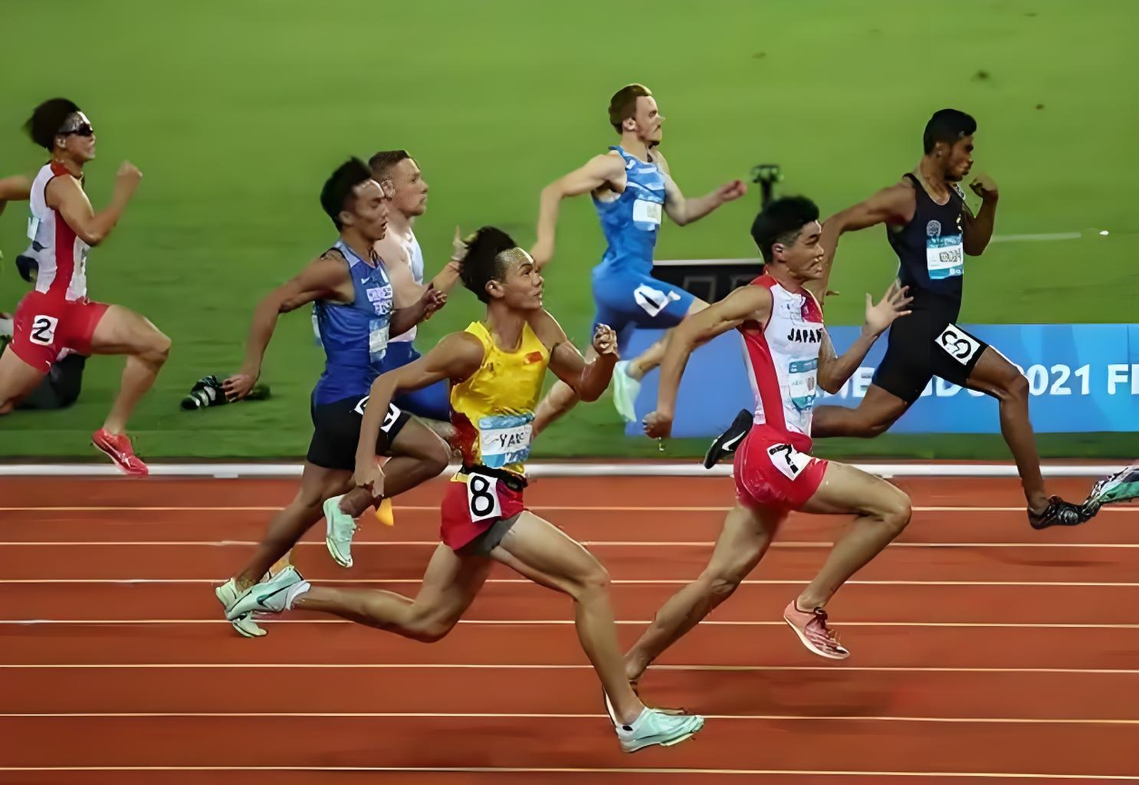

Picture Description
How fast these athletes run!

Slide 4
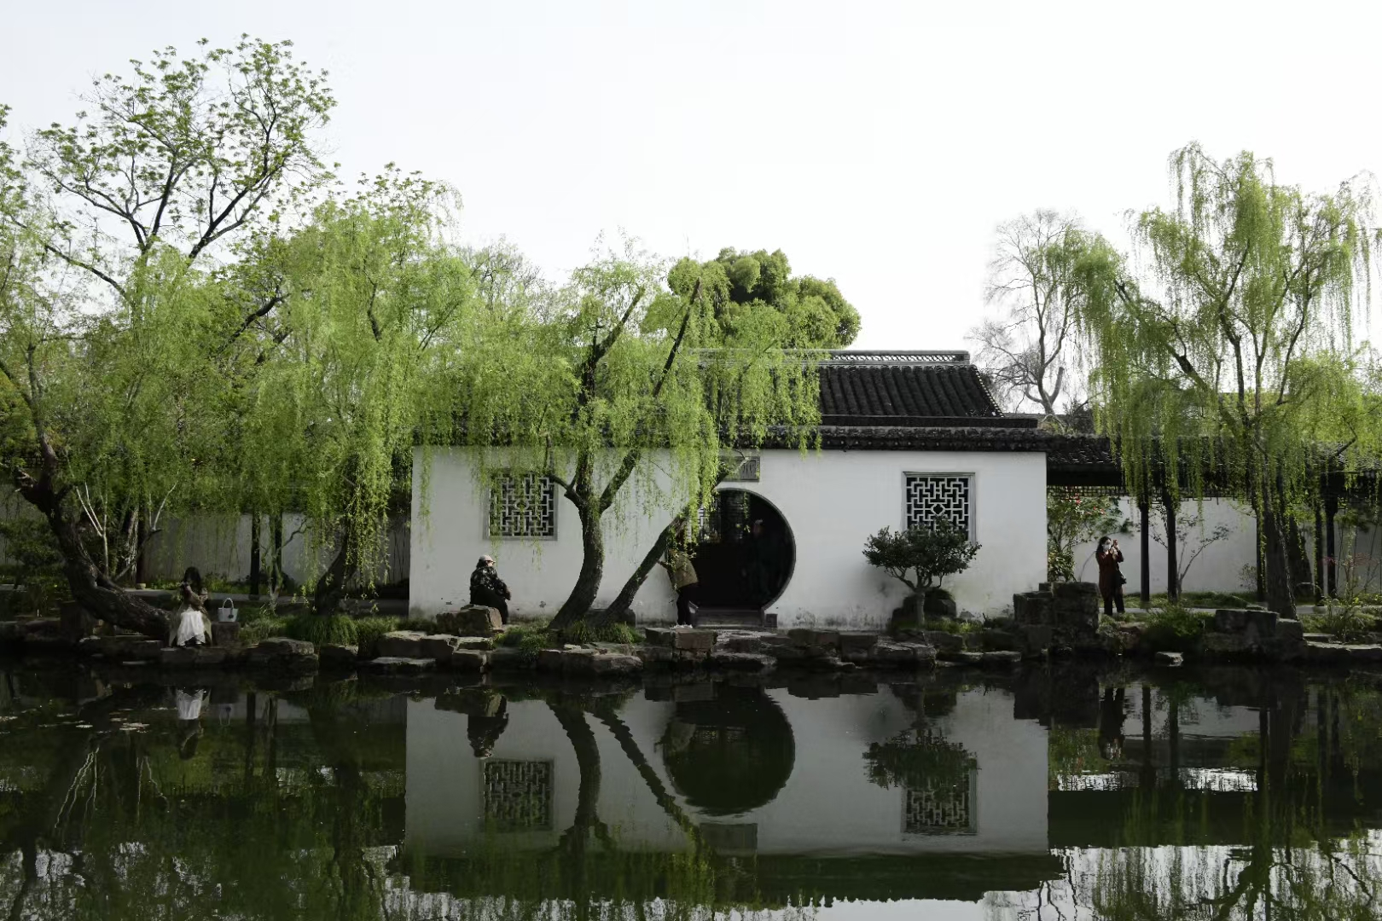
Picture Description
How beautiful the place is!

Slide 5

Picture Description
How time flies!

Slide 6
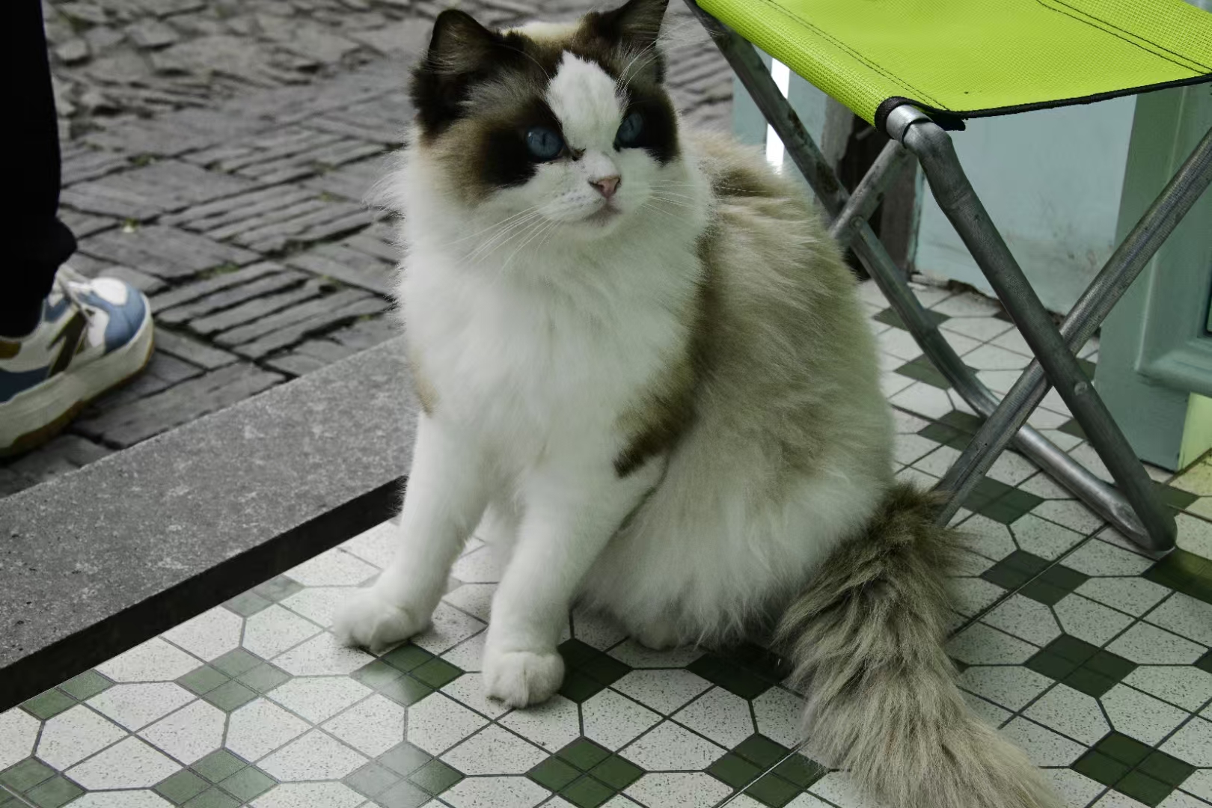
Picture Description
What a cute cat it is!

Slide 7
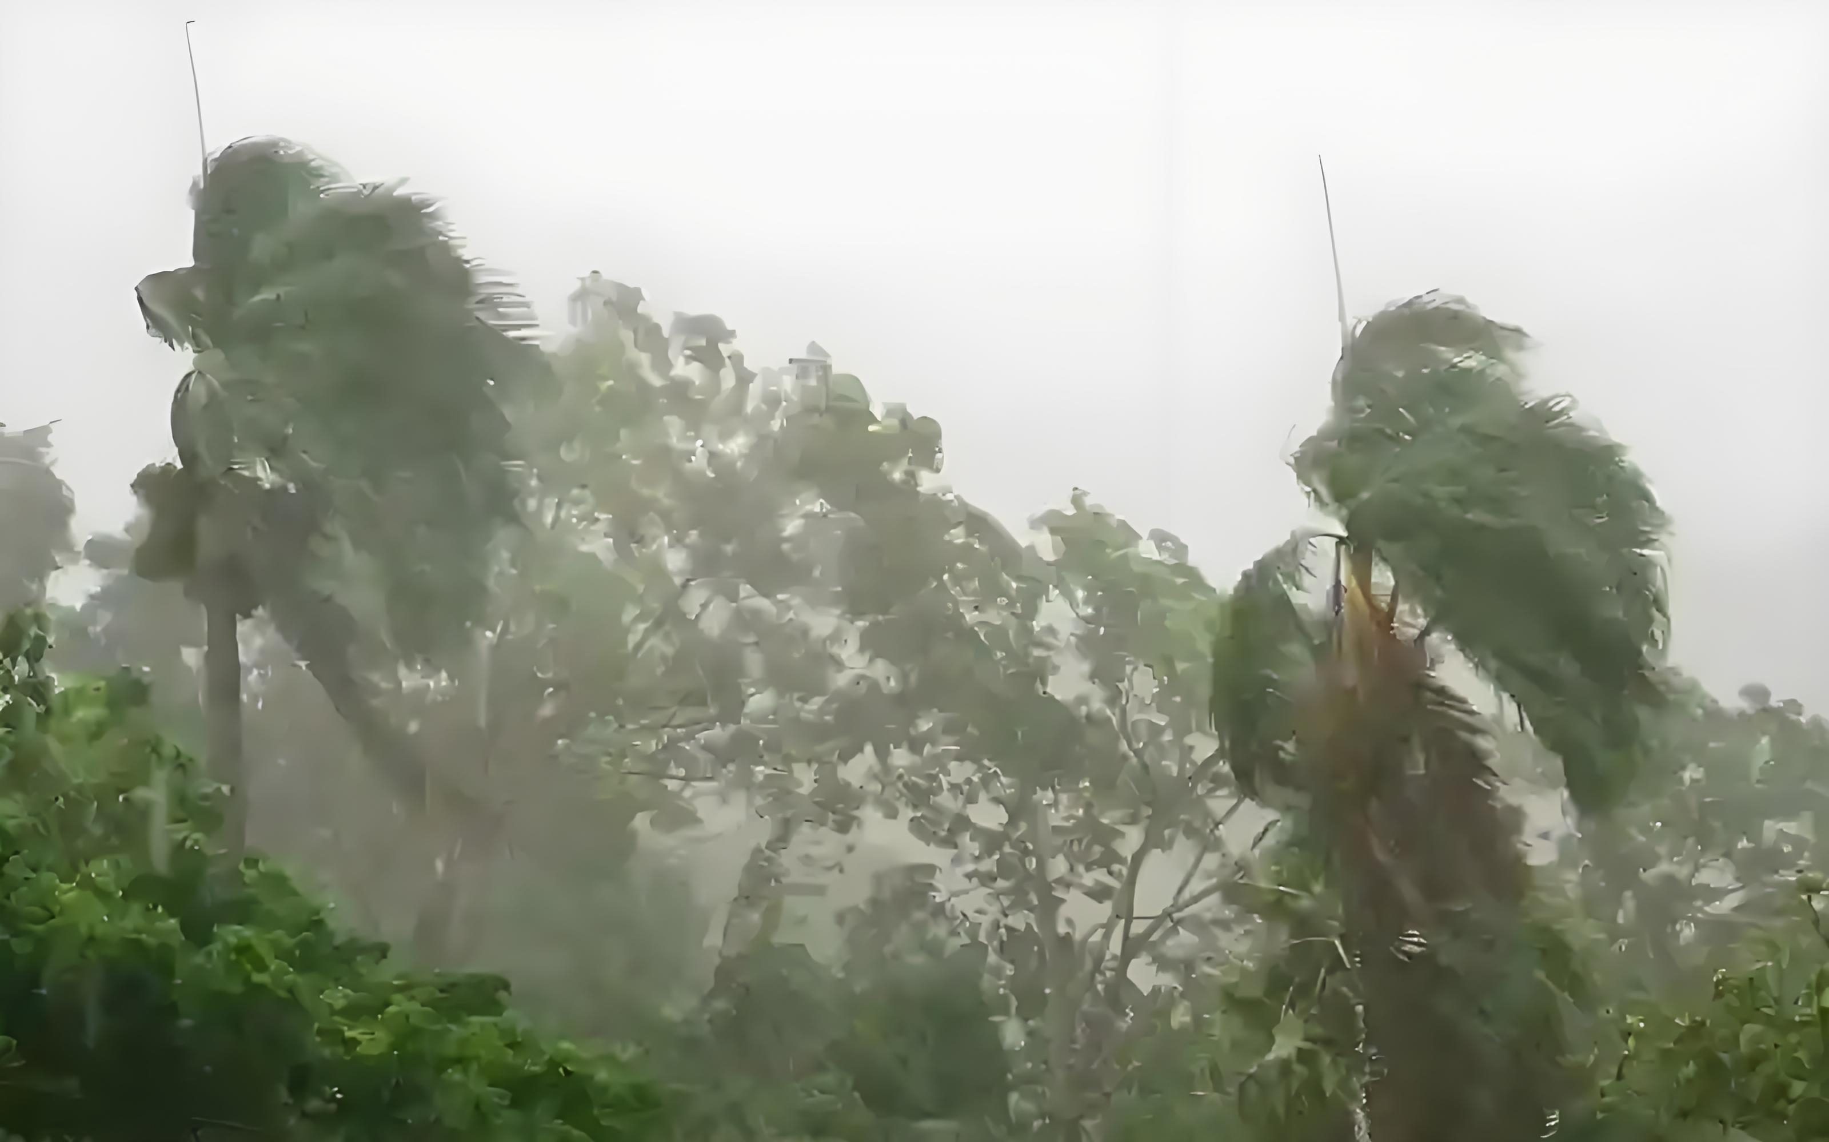
Picture Description
What bad weather it is!

Slide 8
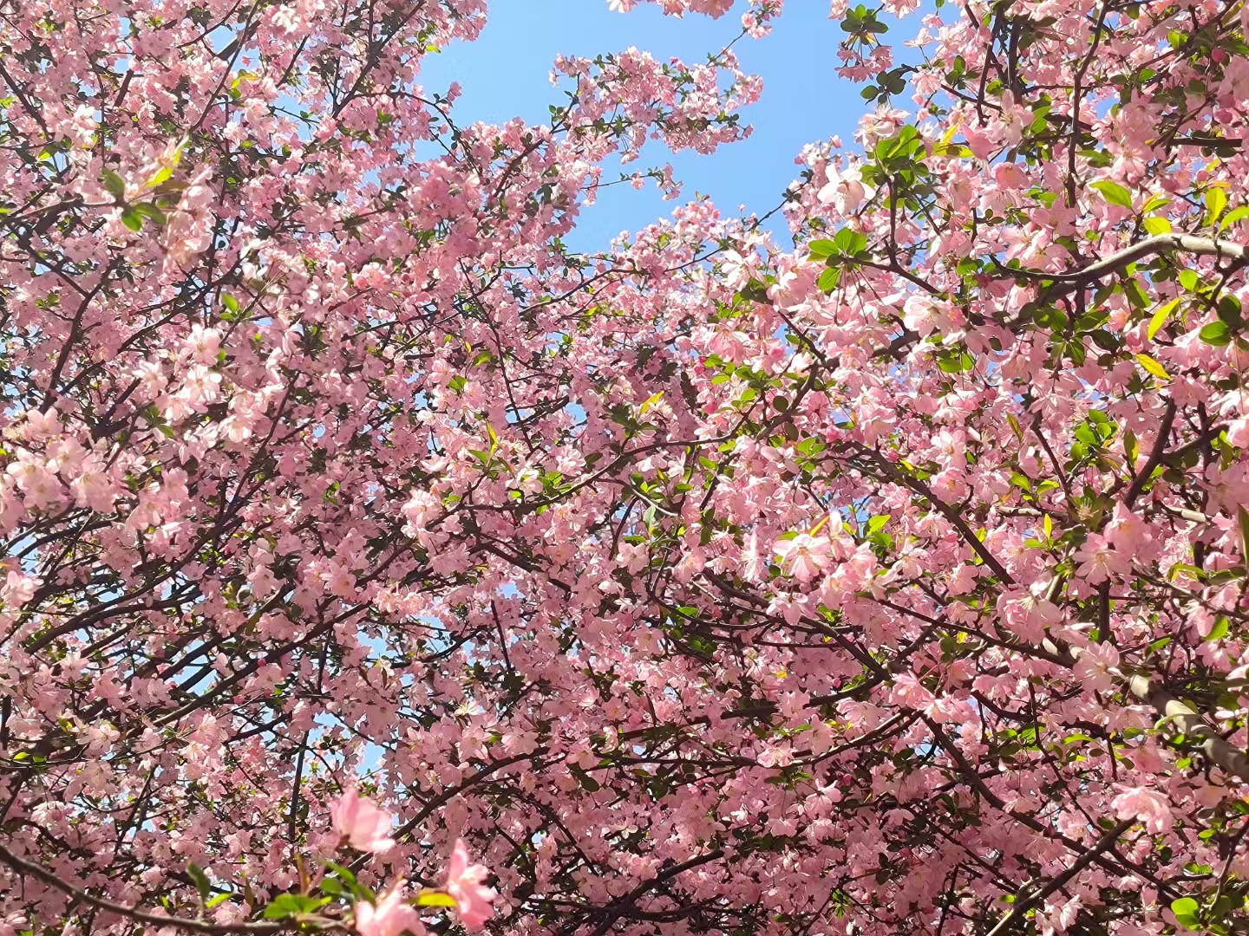
Picture Description
What beautiful flowers they are!

Slide 9
Definition
Sentences that express strong emotion, such as surprise, admiration, anger, excitement or other intense feelings. And it typically ends with an exclamation mark(!).

Slide 10
Discovery: sentence patterns
How fast these athletes run!
How beautiful the place is!
How time flies!
What a cute cat it is!
What bad weather it is!
What beautiful flowers they are!

Slide 11
Discovery: sentence patterns
How fast these athletes run !
How beautiful the place is !
How time flies !
How adv. subject v.
How adj. subject v.
How subject v.
How + adj./ adv.+ subject + v. !/ How +subject + v. !

Slide 12
Discovery: sentence patterns
What a cute cat it is !
What bad weather it is !
What beautiful flowers they are !
What noun phrases subject v.
What +noun phrases +subject+ v. !

Slide 13
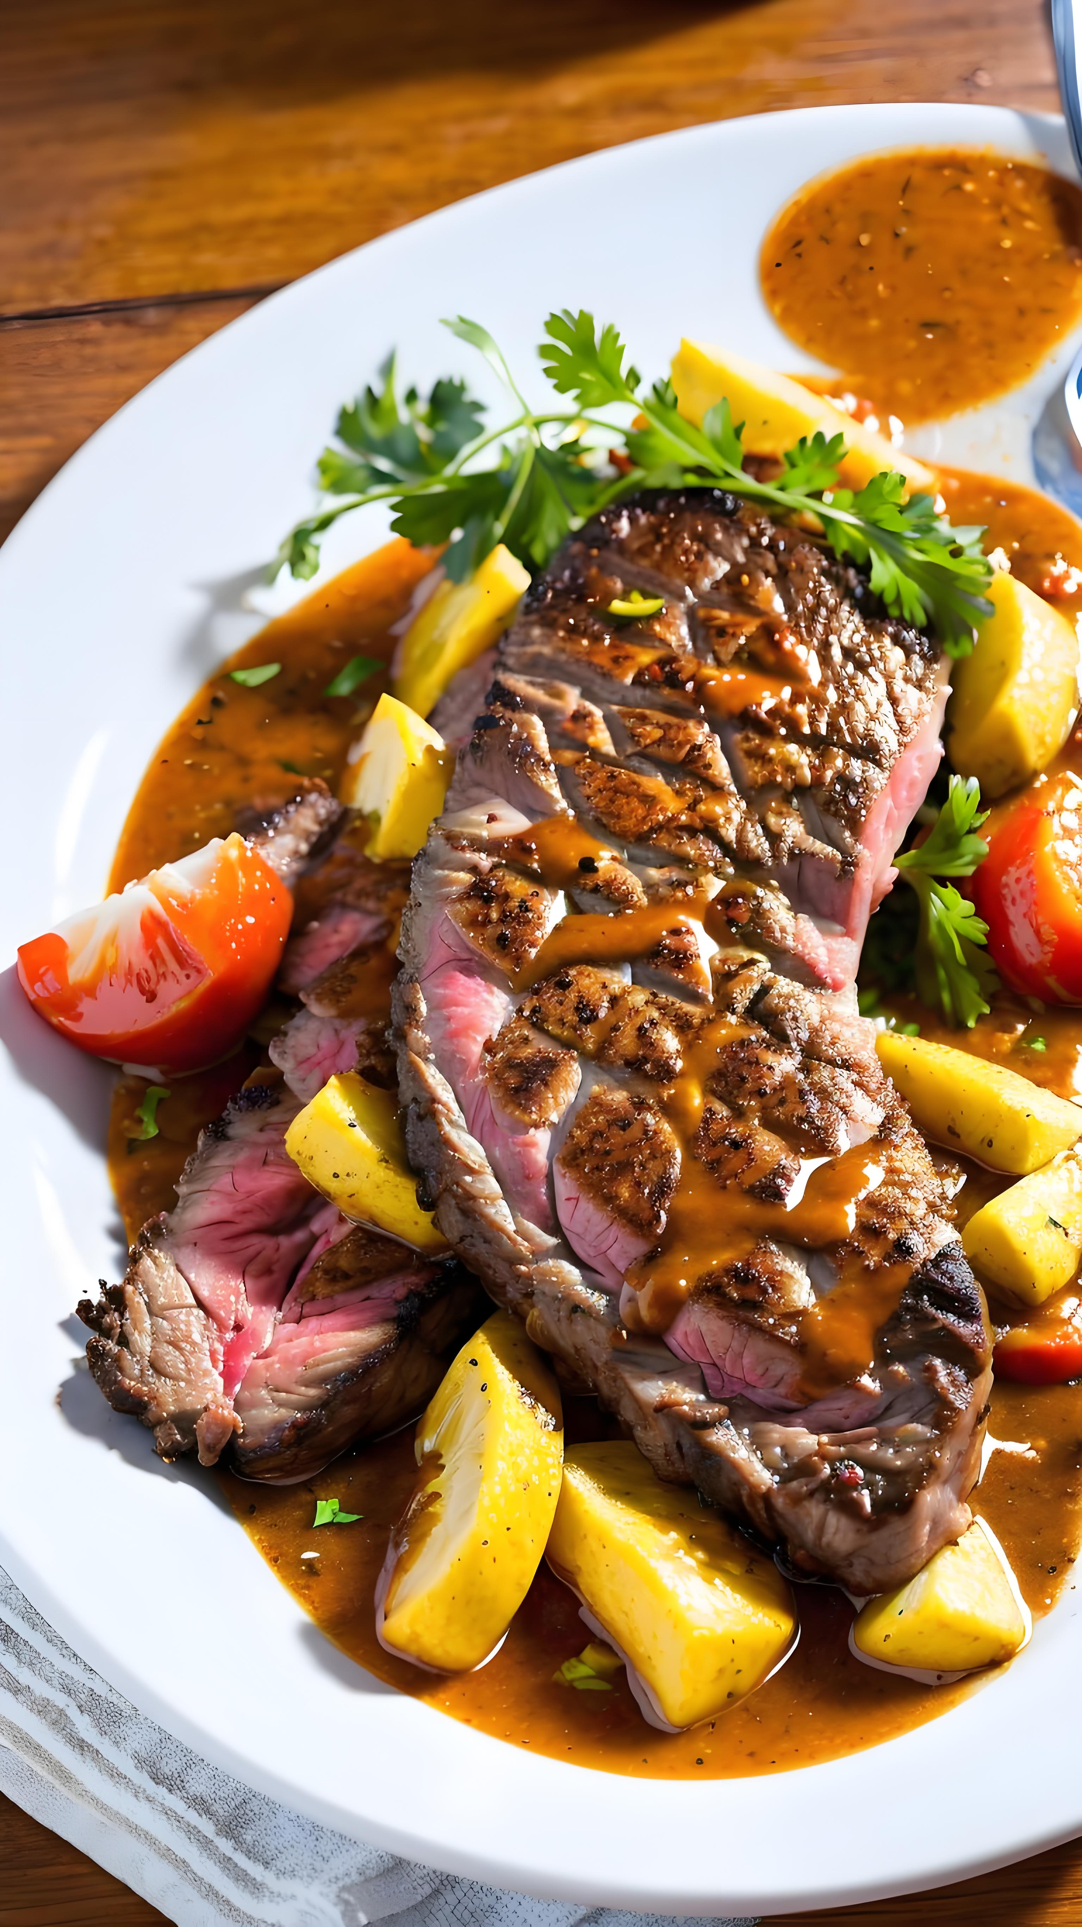
Practice: word order
The food is delicious .
How
delicious
the food
is
!

Slide 14
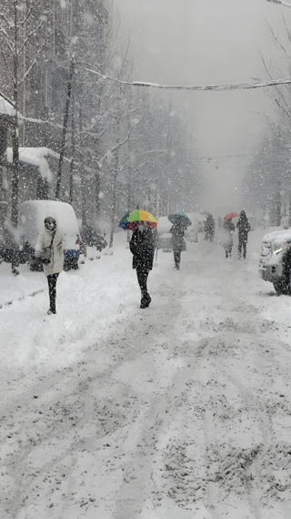
Practice: word order
It snows heavily .
How
heavily
it
snows
!

Slide 15
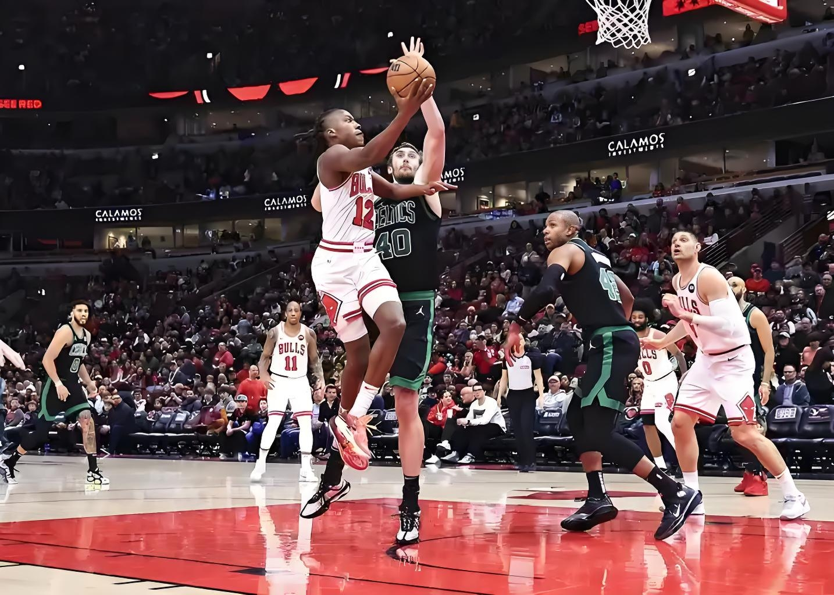
Practice: word order
It is a wonderful match .
What
a wonderful match
it
is
!

Slide 16

Practice: word order
That is bad news .
What
bad news
that
is
!

Slide 17
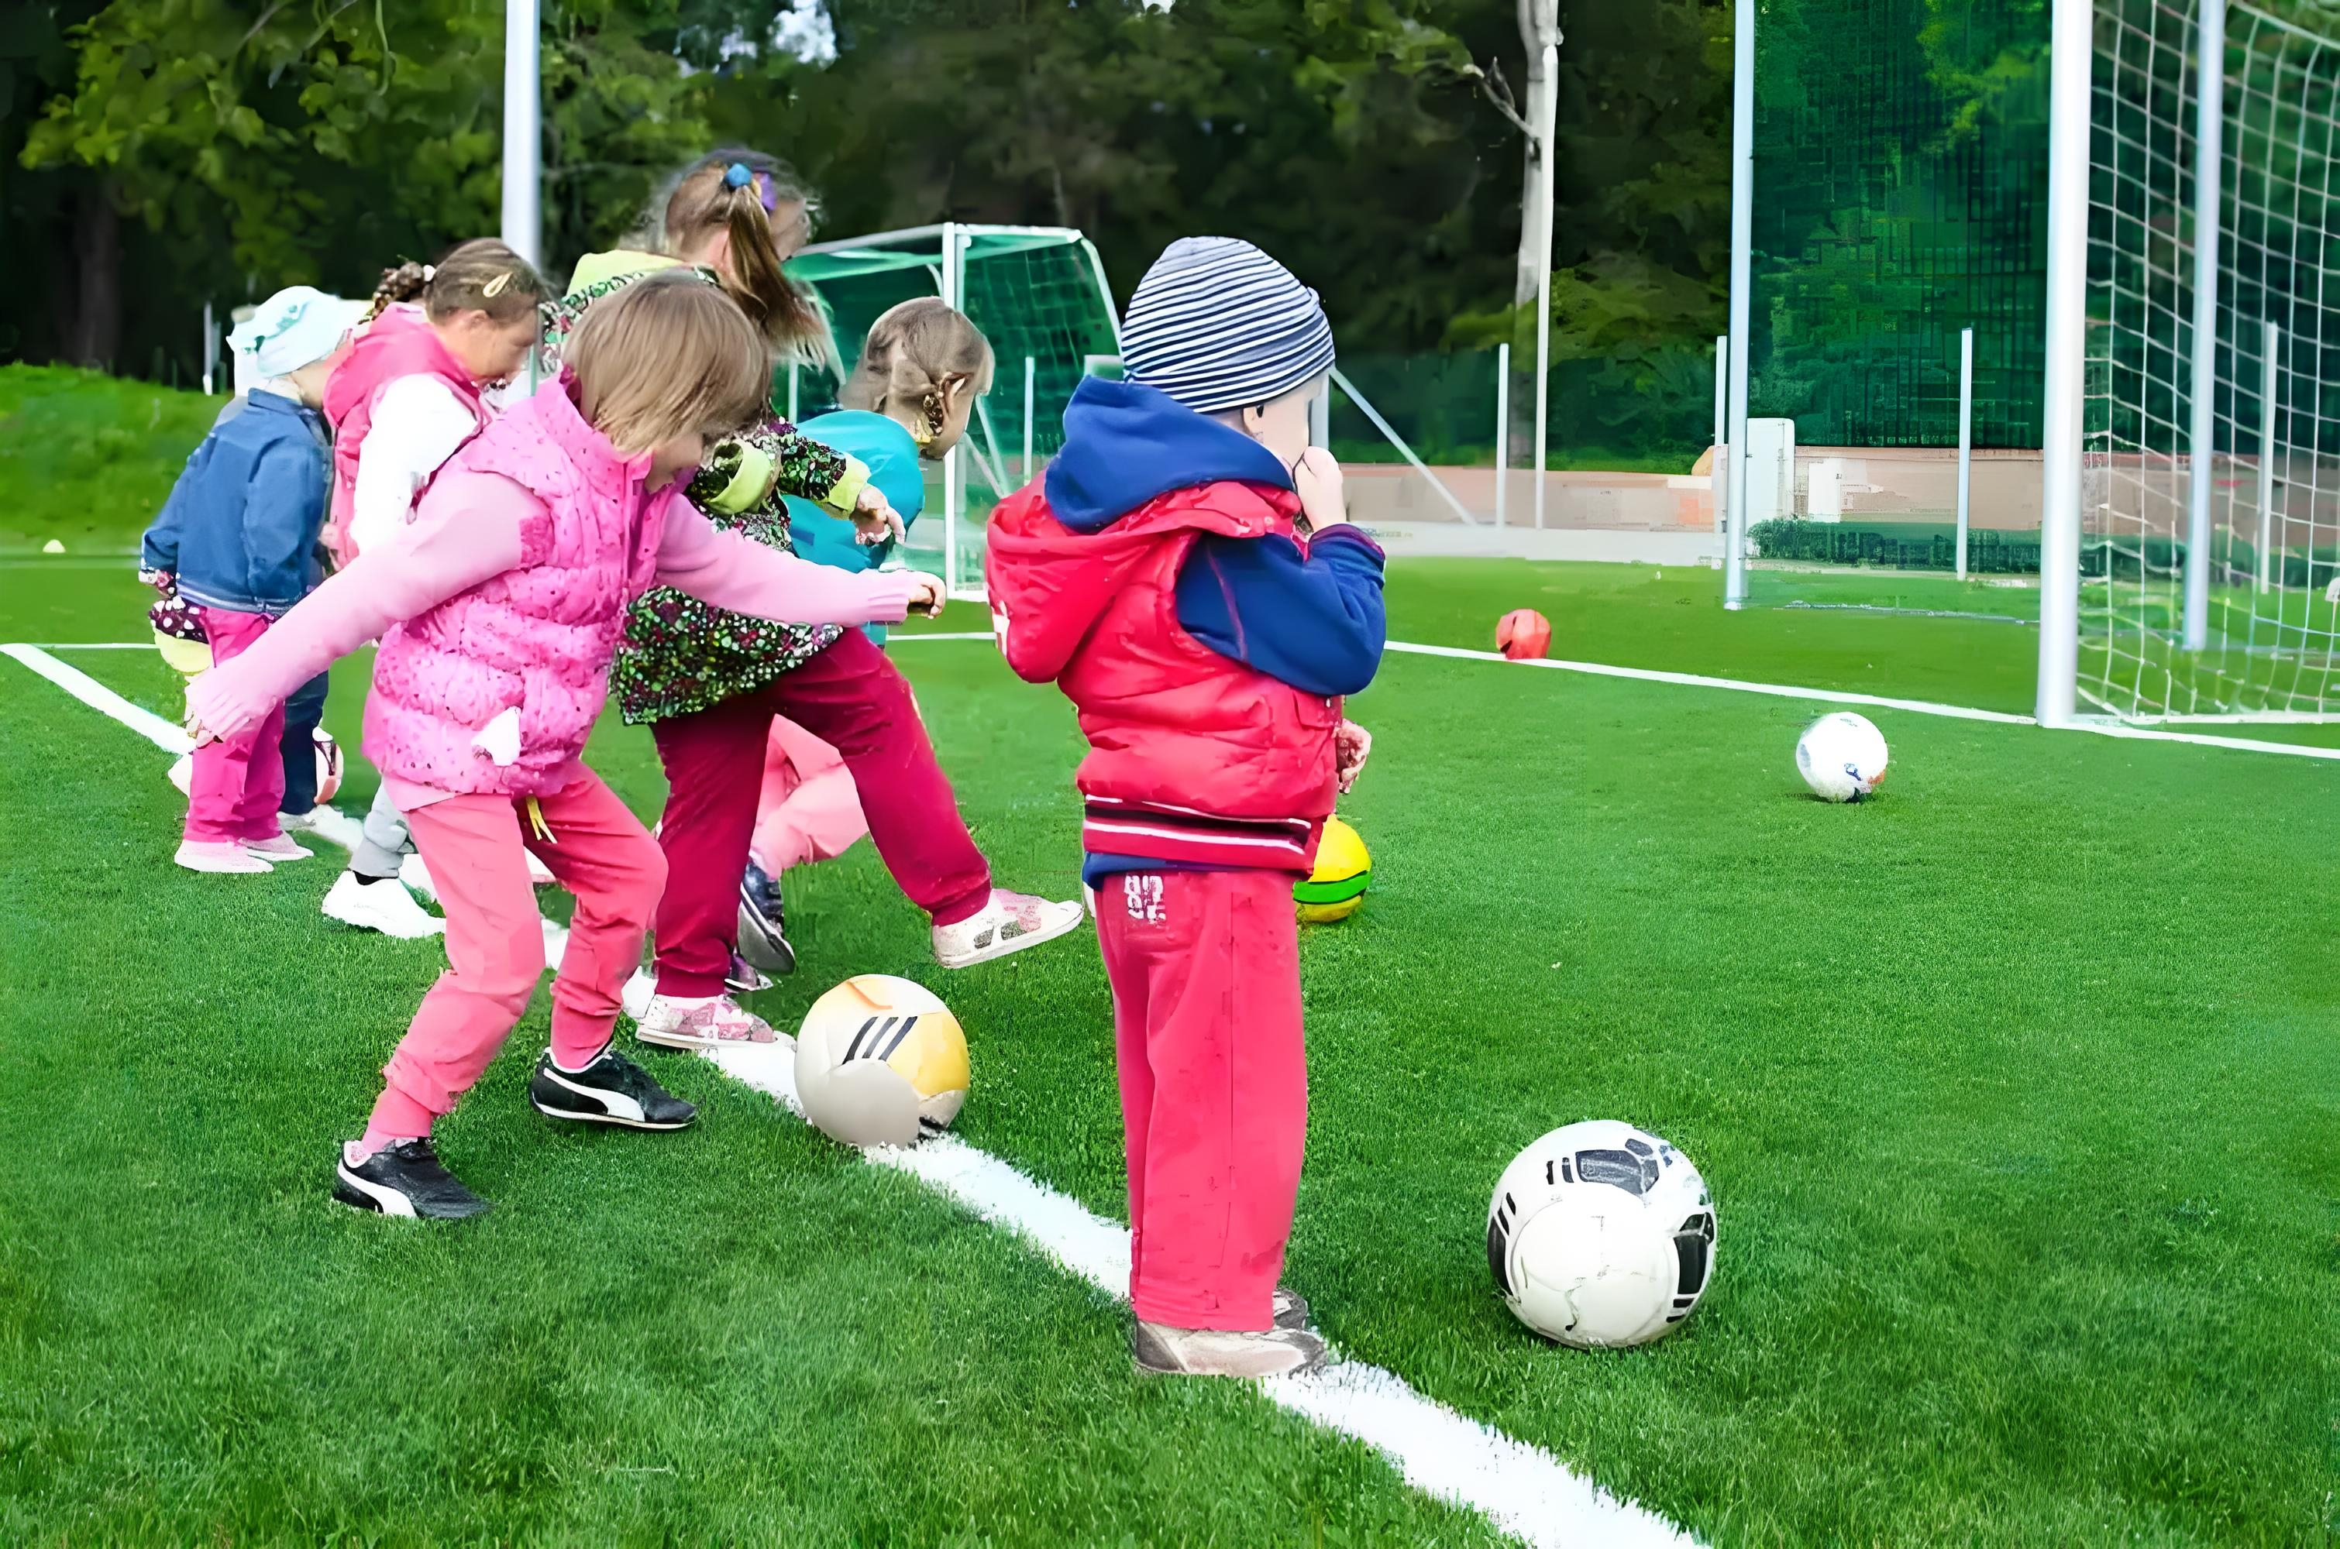
Practice: word order
They are happy children .
What
happy children
they
are
!

Slide 18
Discovery: “what” or “how”
How adj./adv. subject v. !
What noun phrases subject v. !
Is there any noun?
Yes
No
what
how

Slide 19
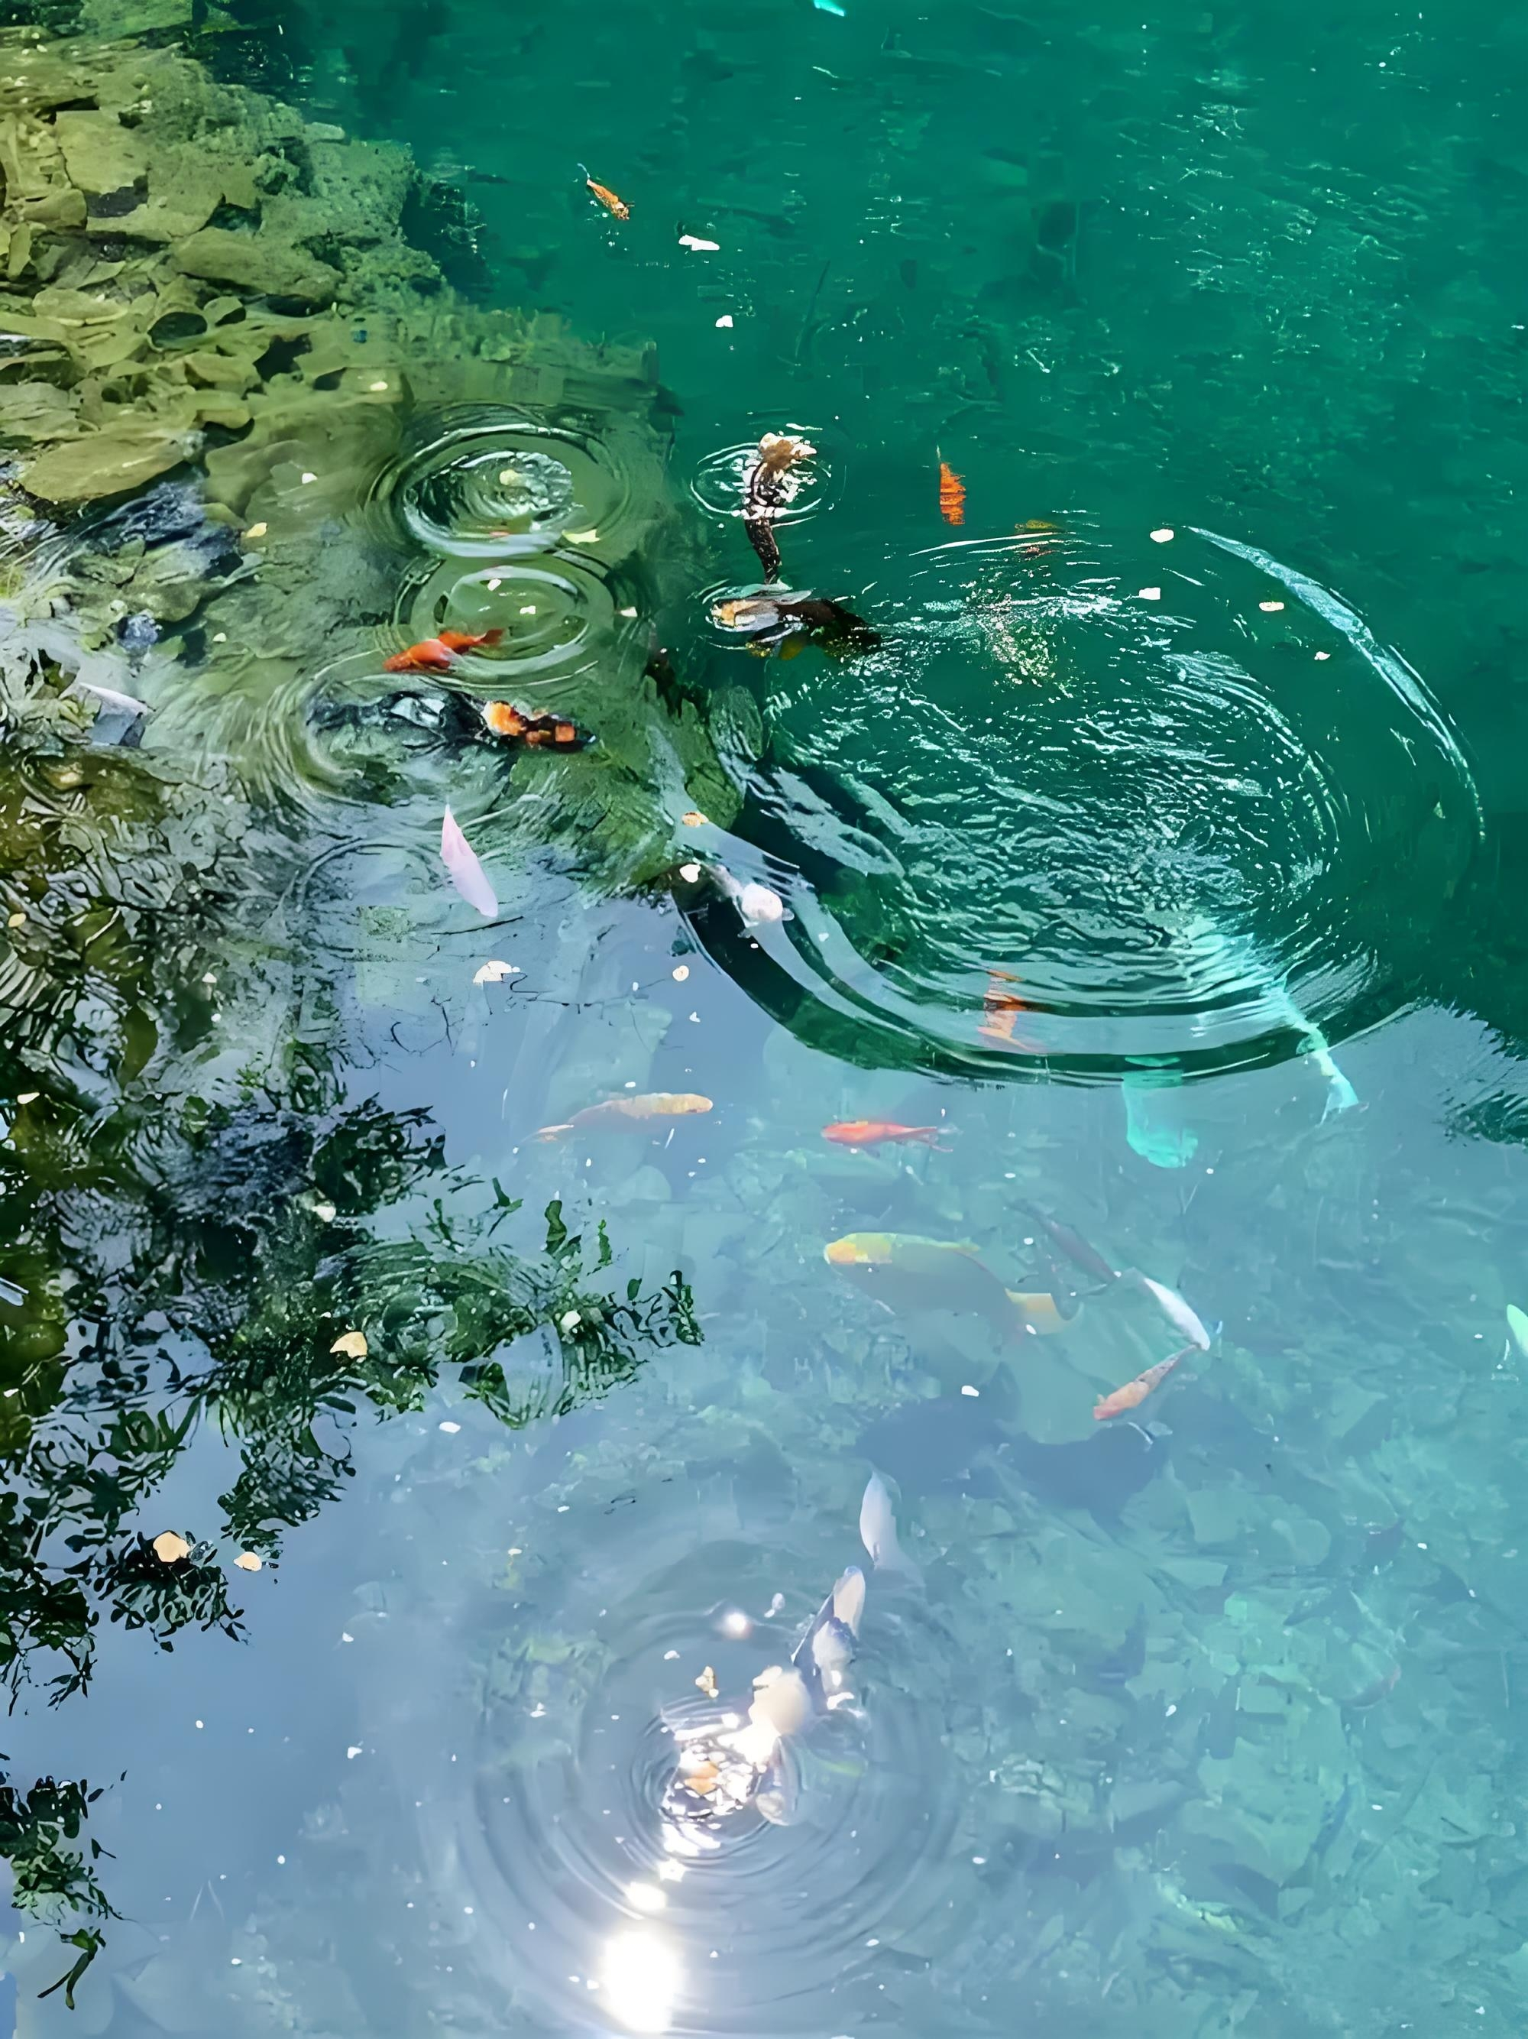
Practice: word choice
How
clear the water is!
clear water it is!
What

Slide 20

Practice: word choice
How
tall these buildings are!
tall buildings they are!
What

Slide 21
Summary
Sentence patterns
How + adj./adv.+ subject + v. !/ How +subject + v. !
What +noun phrases + subject + v. !
Is there any noun?
Yes
what
No
how

Slide 22
Homework
Finish the exercises of choosing “what” and “how” on page 45
Make 10 exclamations with “how” and “what”
Record a video using at least three exclamations to describe your weekend

